Slide 1

International Operations Management

Slide 2
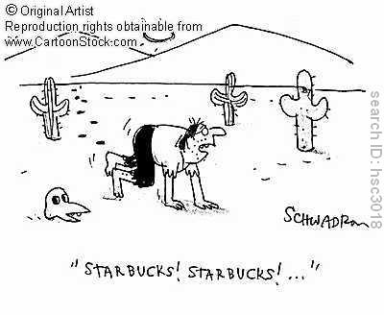
Typical day....
(S)he puts on a pair of Nikes and spreads some Ferrero Nutella on her toast. Her Toyota Corolla provides economical transportation to school. She downs a Big Mac at lunch with the help of a Coke Light (or a Diet Coke Light if she’s in USA) while text-messaging on her Samsung cell-phone. Her day is only half over, but
multinational
corporations have already
clothed, transported, fed, and
transmitted her.

Slide 3

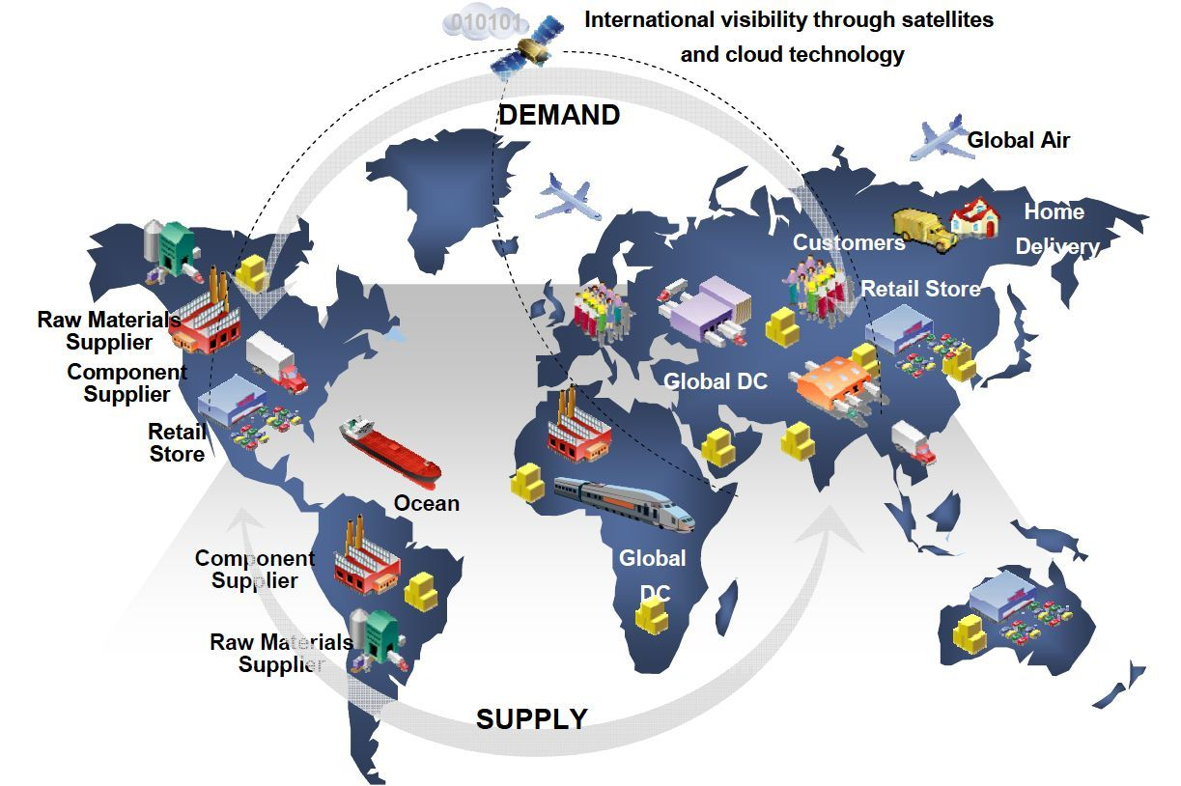
Global Supply Chain
Scary and Larsen observe, “managing the supply chain is vital for international business. The alternate objective is to deliver products to market with variety, responsiveness, timeliness and efficiency. Corporate strategy must include organising; coordinating and executing the processor product flow as a competitive necessity and as a source of potential competitive advantage.”

Slide 4
According to Houlihan, the underlying concept of the supply chain embraces the following points
The supply chain identifies the complete process of providing goods and services to the final user.
It includes all parties and logistics operations from supplier to customer within a single system.
The scope of the supply chain includes procurement, production and distribution operations.
The supply chain extends across organisational boundaries.
It is coordinated through an information system accessible to all members.
The primary objective of the supply chain is service to customers. This must be balanced against costs and assets.
Objectives of individual supply chain members are achieved through the performance of the chain as a whole.

Slide 5
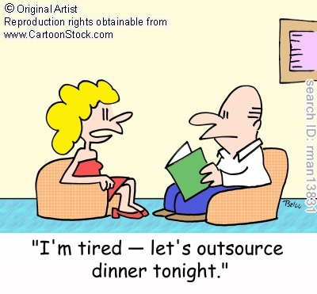
One of the critical considerations in the supply chain management is
Do I Make or Do I Buy?

Slide 6
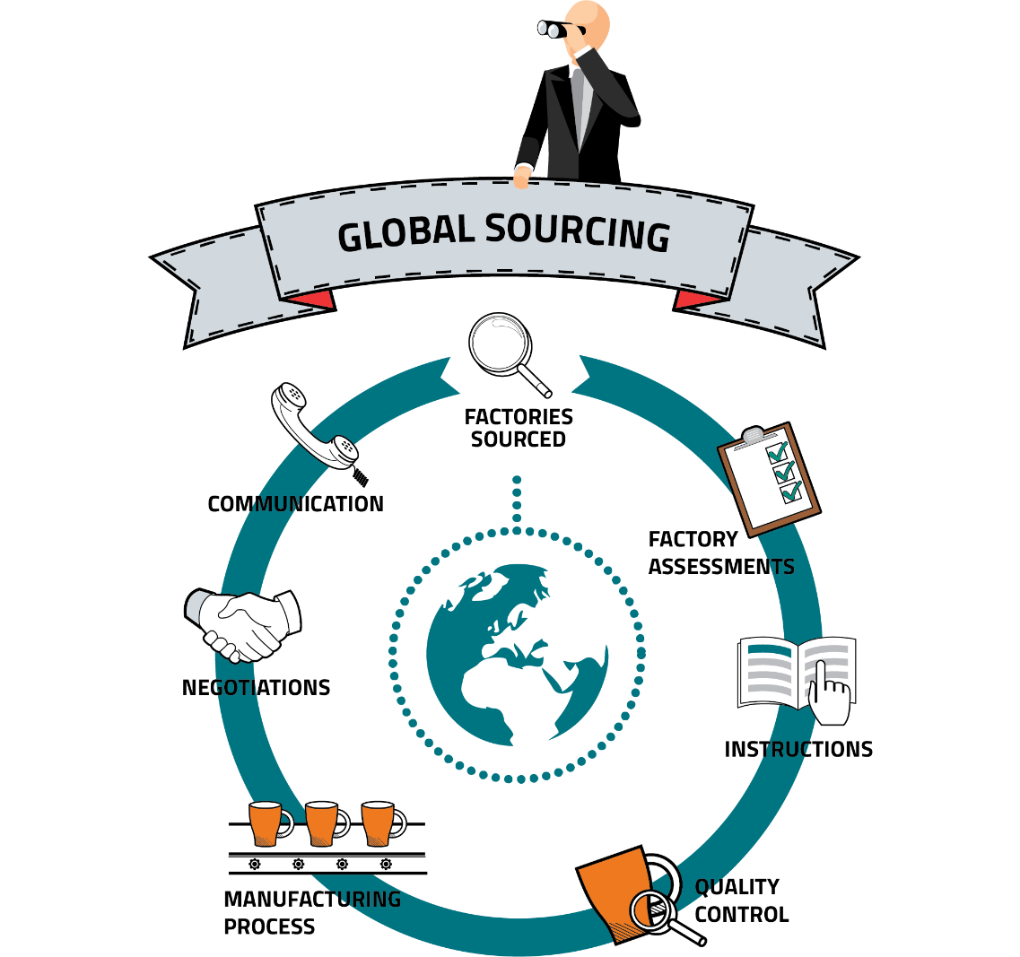
Global Sourcing
1. Lower price.
2. Better quality
3. Only source available
4. More advanced technology
5. More consistent attitude
6. More co-operative delivery
7. Counter trade requirements

Slide 7

Partnering / Relationship Marketing
According to Anderson and Narus, partnering “is a process where a customer firm and supplier firm form strong and extensive social, economic, service, and technical ties over time, with the intent of lowering total costs and/or increasing value, thereby achieving mutual benefit.”

Slide 8
Partnering / Relationship Marketing
Supplier-Partners: These are the most important suppliers. The business builds intense, involved relationships with them and the important focus of the cooperation is innovation, the development of new expertise and new opportunities.
2. Preferred suppliers: This category is less important than the first and there is not the same degree of mutual dependence as in the first category. The company works closely with them on issues such as quality, logistics and price to gain mutual benefit.
3. Commercial Suppliers: These are the least important suppliers and although the company will encourage better performance in terms of quality etc. it is unlikely to get involved in helping the supplier to achieve it.

Slide 9
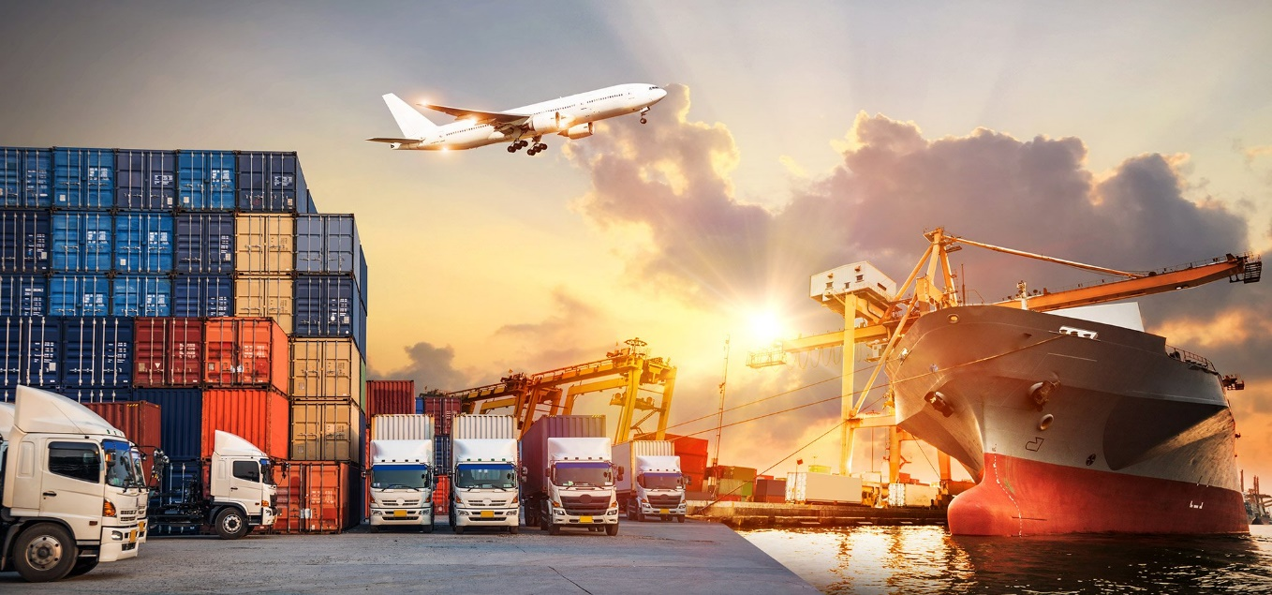
International Logistics
According to the Council of Logistics Management, USA, logistics management is the “process of planning, implementing and controlling the efficient, cost effective flow and storage of raw materials, in process inventory, finished goods, and related information from point of origin to point of consumption for the purpose of conforming to customer requirements.”

Slide 10
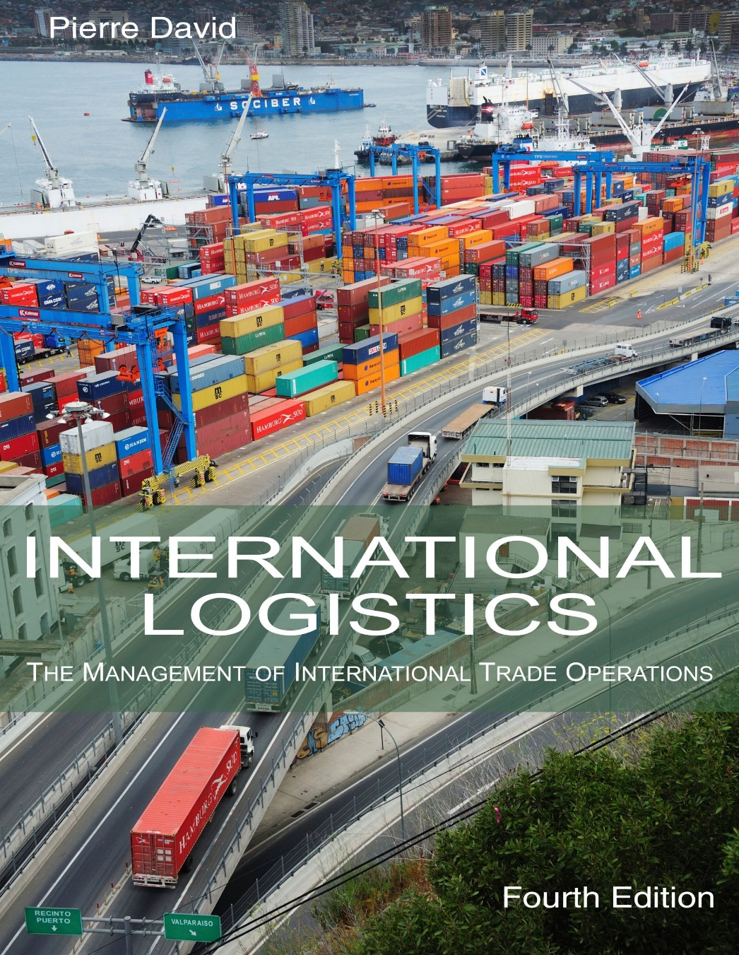
Components of Logistics
Inventory management
Warehousing and storage
Transportation
Materials handling
Order processing
Distribution
Communications
Packaging
Salvage and scrap disposal
Returned goods handling
Customer service

Slide 11
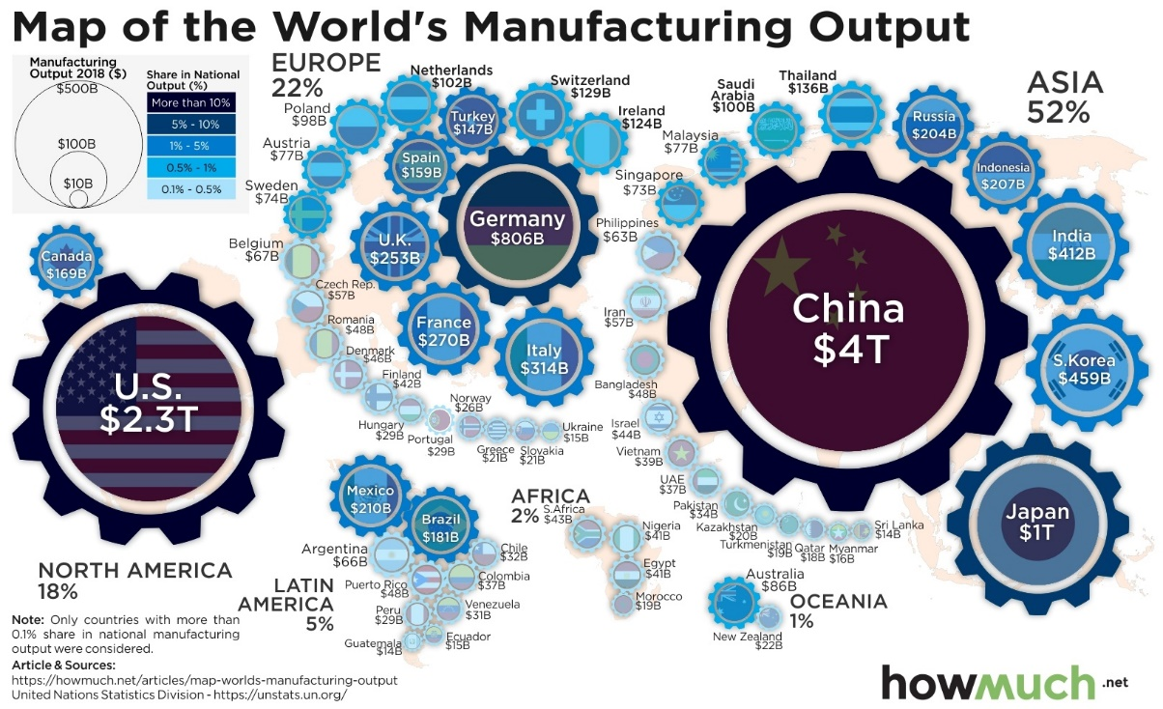
Cs of Global Manufacturing
Compatibility - the degree of consistency between the foreign investment decision and the company’s competitive strategy
Configuration - strategy of centralisation or dispersion of manufacturing facilities
(centralised facility, regional facilities, and multi-domestic facilities)
Coordination
Control

Slide 12
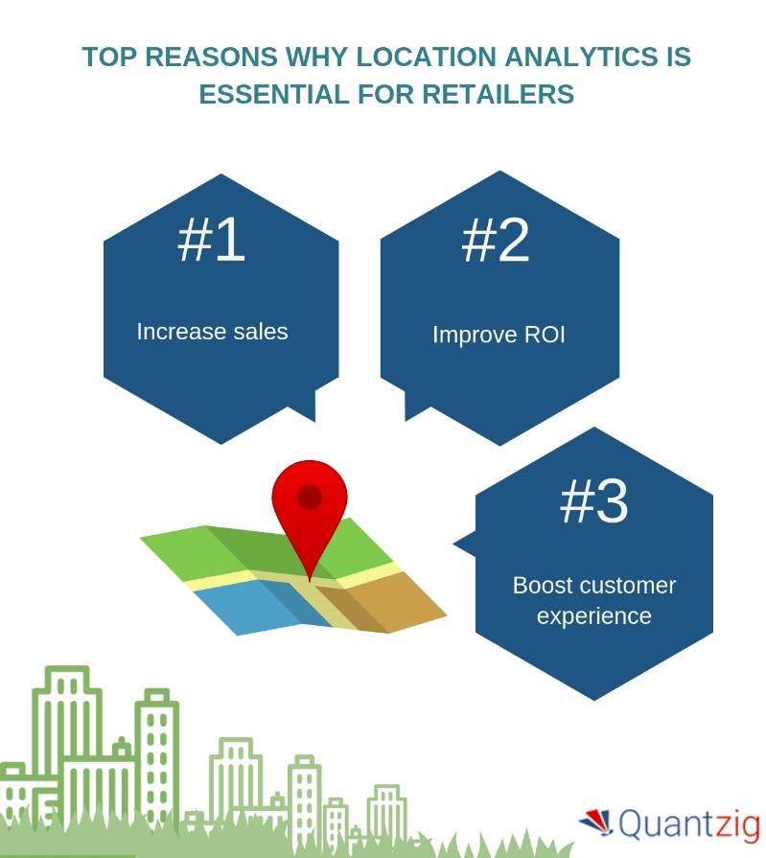
Location Strategy
Nature of Organisation
Cost
Exchange Rate Variation
Logistical Factors
Product Life Cycle and Pattern of Demand
Nature of Product
Government Policies and Regulations
Social and Political Factors

Slide 13
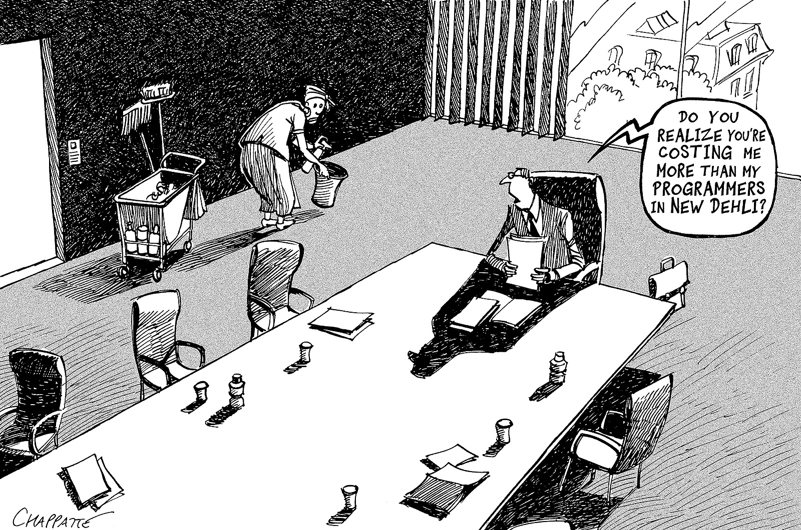

Slide 14
